Slide 1
Travel Time (Un)Reliability Sensitivity Tests Using an Activity-Based Model:
A San Diego Study
Wu Sun & Yun Ma
San Diego Association of Governments
2019 TRB Application Conference | June 4, 2019

Slide 2
Background
Travel time (un)reliability has rarely been considered until recently.
SANDAG’s ABM2 travel time (un)reliability modeling follows SHRP2 C04 recommendations.
Test sensitivities of performance metrics to travel time (un)reliability.

Slide 3
Methodologies
Generalized cost function for highway utility
Travel time variability regression model
INRIX data used in creating regression model

Slide 4
Scenarios & Performance Metrics
Test Scenarios
Performance Metrics
Mode shares
Vehicle delay & VMT
Trip length
Elasticities to (un)reliability
Scenario | (Un)Reliability
2 | 50%
1 | base
3 | 100%
4 | 200%

Slide 5
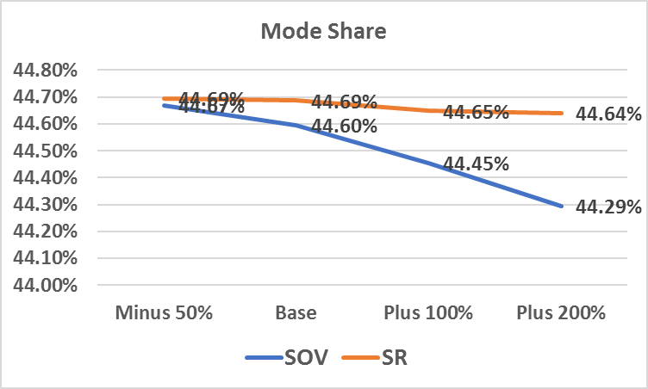
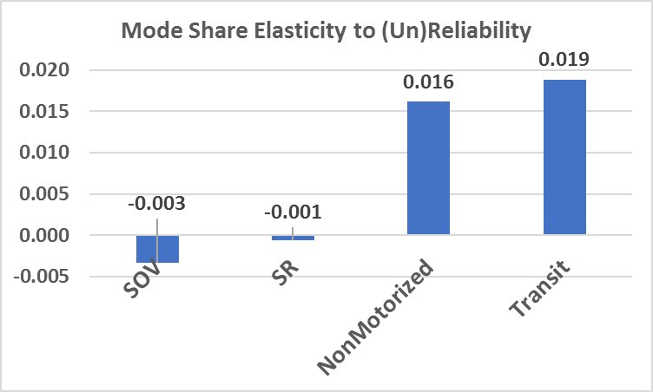
Sensitivity Test Results-1

Slide 6
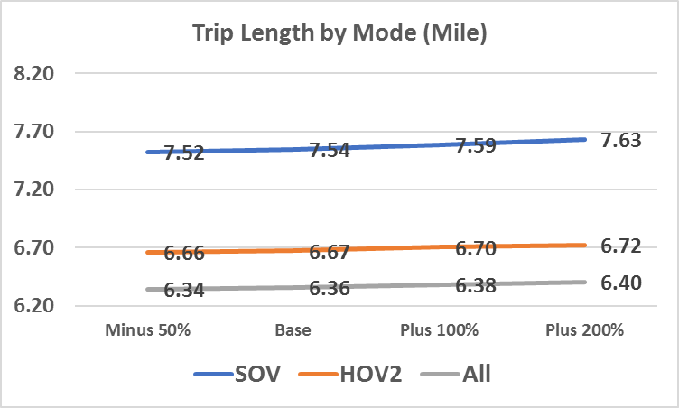
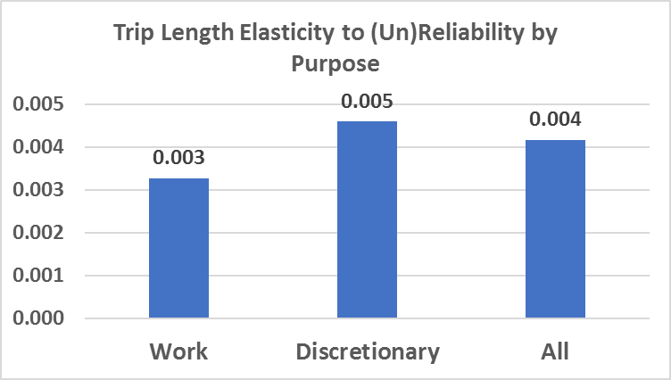
Sensitivity Test Results-2

Slide 7
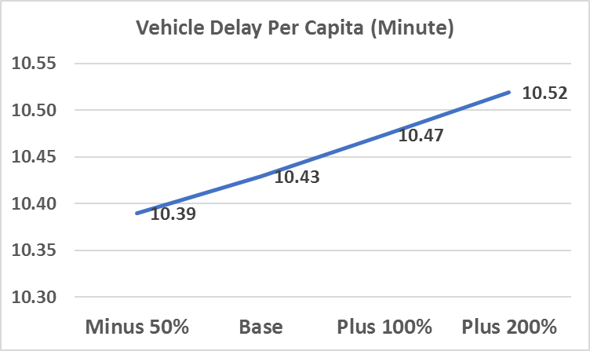
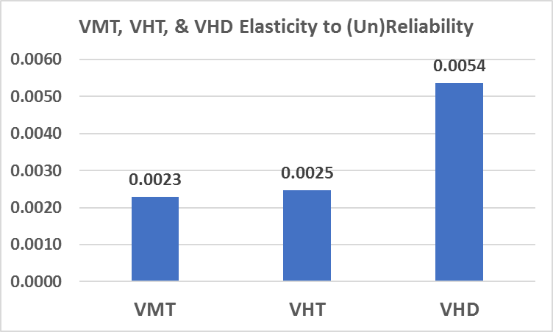
Sensitivity Test Results-3

Slide 8
Conclusions
Modeling travel time (un)reliability becomes possible with big data.
Activity-Based Model is suitable for incorporating travel time (un)reliability
Performance metrics show limited sensitivity to travel time (un)reliability; as travel time (un)reliability increases:
SOV mode share decreased more than SR
Trip length increases slightly
Vehicle delay increases slightly
Vehicle delay shows larger sensitivity than VMT

